Slide 1
PBCore Mappings and Database Modeling

Slide 3
What is a metadata mapping and why is it important?

Slide 4
What is a metadata mapping and why is it important?
Example 1:
A public media station is closing and wants to donate their materials to the local university library. The public media station has been cataloging their materials in PBCore, but the library’s catalog is in MARC. If the PBCore fields are mapped to MARC, the library can write a program to transform the data and ingest the records into the catalog system.

Slide 5
What is a metadata mapping and why is it important?
Example 2:
An amateur filmmaker has donated their home movies to a local historical society. The filmmaker has a personal system to keep track of their output, and the historical society uses PBCore to catalog moving images. If the historical society creates a mapping from the donor’s system, they can transform and accession their metadata.

Slide 6
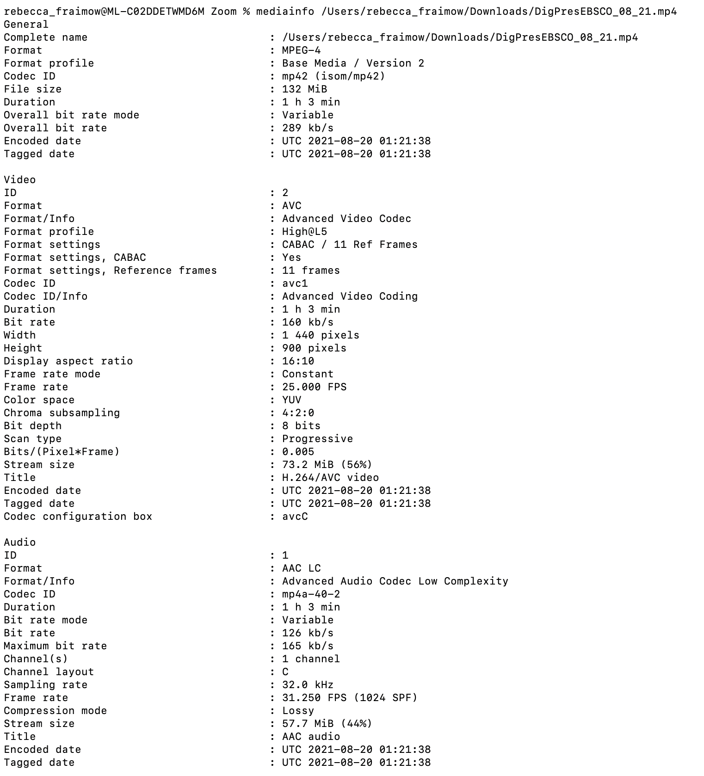
The same data can be expressed in many different ways
Notes:
Demo how to get this result with MediaInfo: mediainfo [file] in Terminal

Slide 7
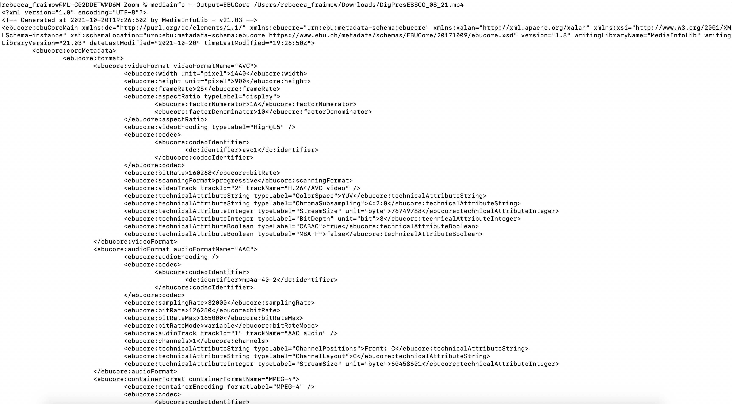
The same data can be expressed in many different ways
Notes:
Demo how to get this result with MediaInfo: mediainfo –Output=EBUCore [file] in Terminal

Slide 8
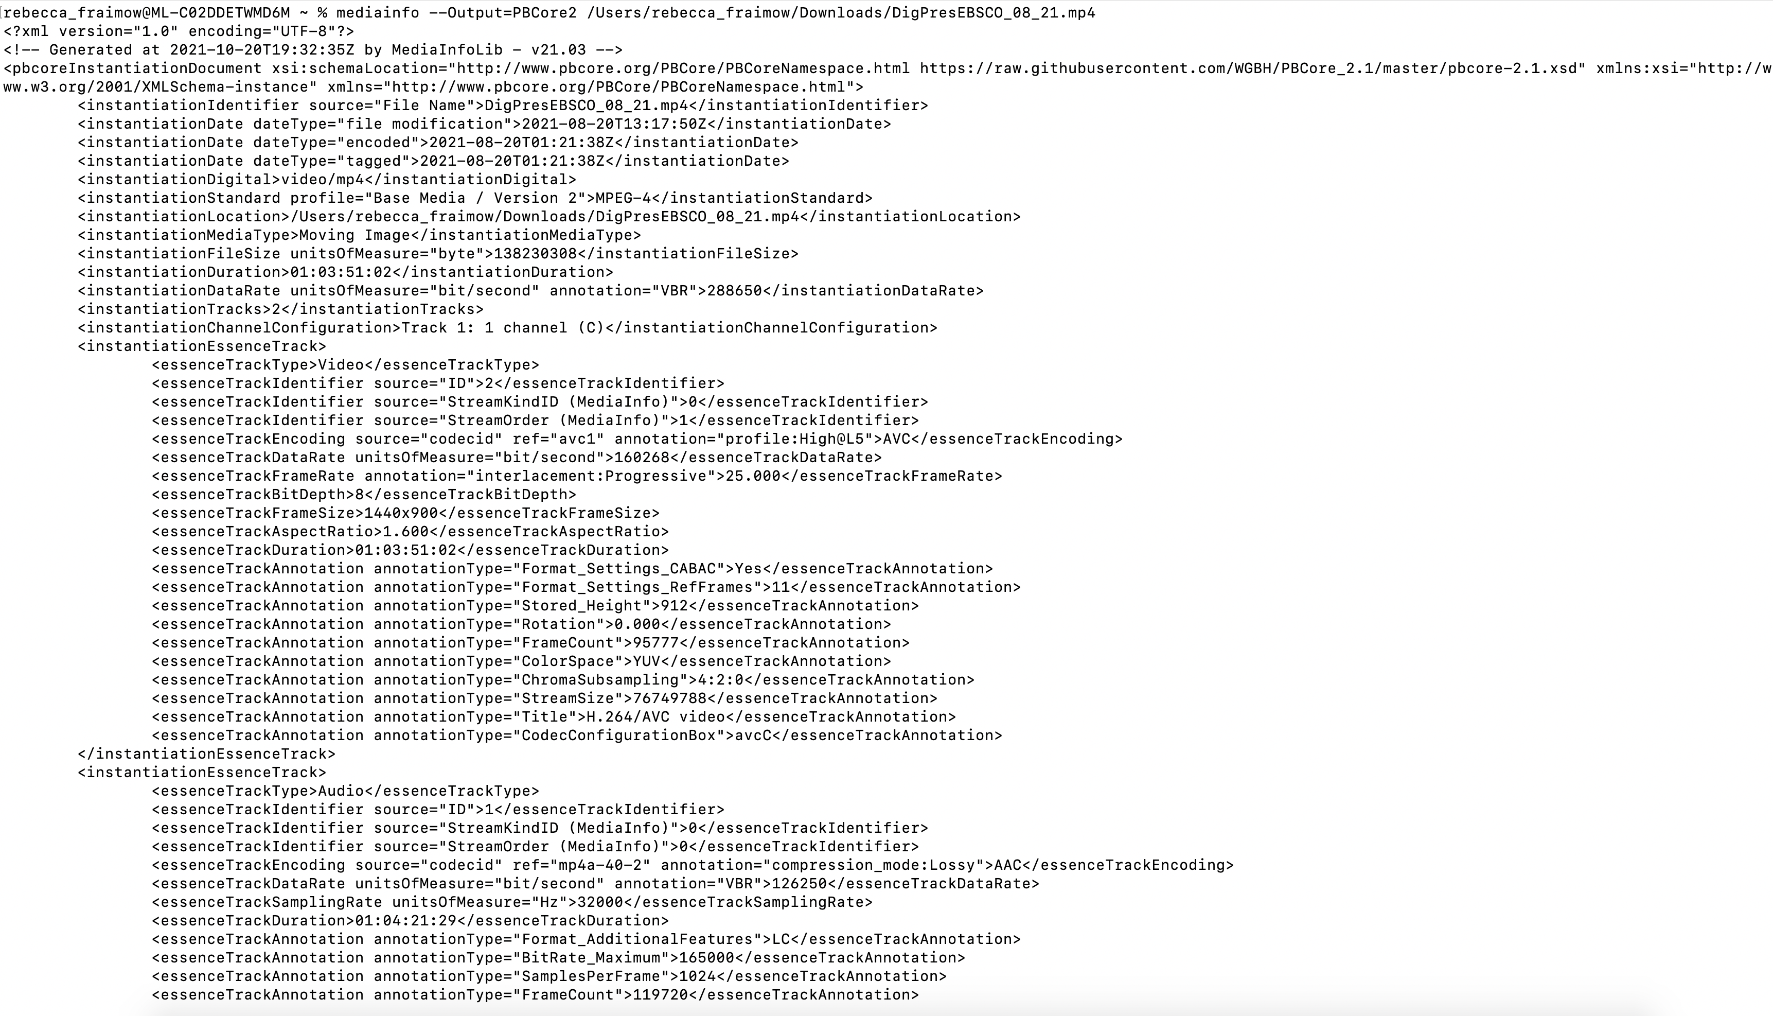
The same data can be expressed in many different ways
Notes:
Demo how to get this result with MediaInfo: mediainfo –Output=PBCore2 [file] in Terminal

Slide 9
What does a metadata mapping look like?

Slide 10
What does a metadata mapping look like?
Source: https://www.iptc.org/std/videometadatahub/recommendation/IPTC-VideoMetadataHub-mapping-Rec_1.3.html
Notes:
This is a metadata mapping that was created by IPTC to map various audiovisual metadata standards to their existing properties (jump to demo)

Slide 11
Metadata mappings should follow logic that can be understood by a machine – make computers do the work!
Notes:
This is an example from our PBCore → MARC 21 mapping. Since MARC breaks down subject fields in a different and more granular fashion than PBCore, this mapping incorporates different logic based on Subject Type.

Slide 12
Existing PBCore Mappings
PBCore → MARC 21
PREMIS → PBCore
PBCore → Dublin Core
PBCore → EBUCore RDF
IPTC Metadata Hub → PBCore
Notes:
Jump to demo at http://pbcore.org/mappings and walk through the mappings; explain limitations of mappings, including: MARC mapping is highly conditional and would require a lot of specific logic to implement in full; PREMIS is more intended to be used in conjunction with PBCore than as an alternative to it and our ‘mapping’ suite consists of mappings for the concepts that overlap and examples of how to use them together; Dublin Core’s limits/lack of a Notes field mean that it’s necessarily a lossy mapping; the PBCore/EBUCore RDF mapping is intended to provide a broad roadmap for how to implement PBCore in Linked Data and also includes properties from Dublin Core, DC Terms, and SKOS; and the IPTC Metadata Hub is a set of properties that can be expressed by multiple technical standards

Slide 13
How is modeling a database to a standard different from mapping between standards?

Slide 14
How is modeling a database to a standard different from mapping between standards?
Mapping between standards:
Decide which XML Elements/metadata properties correspond to other elements/properties

Slide 15
How is modeling a database to a standard different from mapping between standards?
Modeling to a database
Decide which XML elements/metadata properties to use as fields
Decide what type of data can go in those fields
Decide how the fields will related to each other
Decide how to design and label those fields for the user

Slide 16
How is modeling a database to a standard different from mapping between standards?
Modeling to a database
Decide which XML elements/metadata properties to use as fields
Decide what type of data can go in those fields
Decide how the fields will related to each other
Decide how to design and label those fields for the user

Slide 17
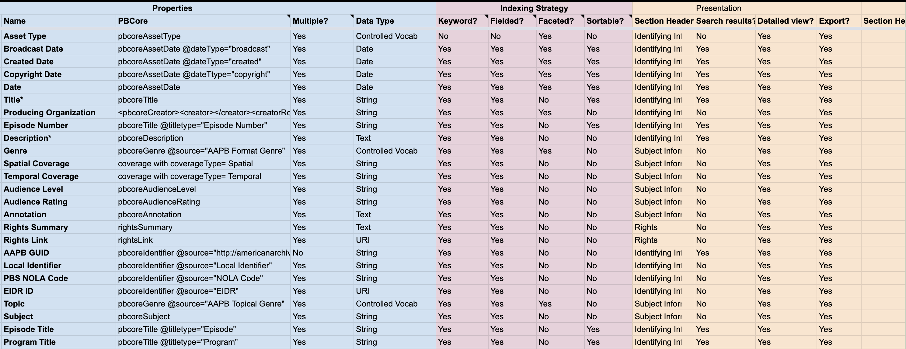
Notes:
Example from AAPB’s AMS2 modeling spreadsheet: https://docs.google.com/spreadsheets/d/1nk4dDClDl_vAXF-1VrMI9jPi9lA9jdUWdIRdQ-gPk-w/edit#gid=105492039
Note: there’s a difference between the name of the field as it will appear in the database, and the underlying PBCore property. Sometimes the same PBCore property, such as pbcoreTitle, or pbcoreIdentifier, may end up broken down into more specific fields within the database, as in Episode Title and Program Title, or AAPB GUID and Local Identifier. This doesn’t mean the database isn’t PBCore-compliant, just that PBCore has been adapted to the needs of the local use case. The goal is to make sure that PBCore data can be imported and exported, even if what emerges in the end is not strictly PBCore metadata.
Note also that this spreadsheet specifies what kind of data should go in the fields for our institutional use case – such as requiring controlled vocabularies for Asset Type, Genre, and Topic – and how the fields should be indexed within the database, as well as how they should be presented. I’m not going to get too deep into data indexing strategies and how they work here, but I wanted to give you a sense of the kind of decision making that goes into database design.

Slide 18
Title: Star Wars
@titleType: Original
Title: Star Wars: A New Hope
@titleType: Revised
Title: A New Hope
@titleType: Alternate
Title: Star Wars
@titleType: Series
Title: A New Hope
@titleType: Episode
Title: IV
@titleType: Episode Number
Notes:
Remember these examples from previous sessions?

Slide 19
SERIES TABLE
Series Title: Star Wars
Series Description: an American epic space opera media franchise created by George Lucas
Titles:
A New Hope
The Empire Strikes Back
Return of the Jedi
PROGRAM TABLE
Program Title: Return of the Jedi
Program Description: A 1983 American epic space-opera film written and directed by George Lucas
Notes:
Discuss the ‘relationality’ of a database and the concept of relation keys to link different tables. In this example, a database with two tables, one representing descriptions of series and one representing descriptions of individual programs, is linked through the title ‘Return of the Jedi’ so that one can navigate from the series level record to the program level record

Slide 20
Data Types
Uncontrolled
Controlled Vocabulary
Date
Text/String
Numeric
Notes:
Walk through each of these data types

Slide 21
Data Types
Uncontrolled
Controlled Vocabulary
Date
Text
Numeric
“I don’t know what kind of data I might want in this field, so I’m going to allow anything!"
Notes:
Anyone can put any kind of data in this field and it will be unstructured – this might be good for a description field, that might require many different formats

Slide 22
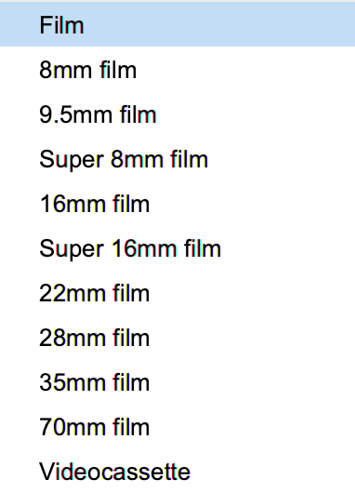
Data Types
Controlled Vocabulary
Controlled Vocabulary
Date
Text
Numeric
Notes:
We’ve talked about controlled vocabularies in previous classes! This will usually be seen in a database as a drop-down list

Slide 23
Data Types
Date
Controlled Vocabulary
Date
Text
Numeric
1977-07-10
Notes:
Any date field should be constrained to the date formatting that your organization wants to use to ensure it’s consistent throughout

Slide 24
Data Types
Text/String
Controlled Vocabulary
Date
Text
Numeric
The data in this field may include letters, numbers, special characters, the dash symbol, or the number sign, and will be interpreted as text by the database
Notes:
For simple data fields like ‘Title’ or ‘Identifier’, it’s often a good idea to constrain it to a string to avoid formatting complications

Slide 25
Data Types
Numeric
Controlled Vocabulary
Date
Text
Numeric
123456.78
Notes:
For fields like ‘File Size’ a constrained numeric field may be helpful to ensure that the database can run calculations like ‘total file size across the collection’

Slide 26
DATABASE
Notes:
Arguably most important element of the database is its ability to both import and export structured data. Databases and asset management systems will inevitably change and evolve; standardized ingest and export will simplify that process considerably.

Slide 27
Case Study: RPI’s Harkness Sports Films
Contributed by Tammy Goebert, Preservation and Access Archivist for Institute Archives and Special Collections at Rensselaer Polytechnic Institute

Slide 28
rebecca_fraimow@wgbh.org
Questions?
Thanks for joining us!
All sessions are available on the course playlist at: https://www.nedcc.org/pbcore-rec

