Slide 1
Introduction: Concepts in Audiovisual Metadata

Slide 2
Notes:
PBCore was originally funded by the Corporation for Public Broadcasting, and GBH took over responsibility for the schema in 2014 as part of the American Archive of Public Broadcasting initiative. Since then, NEH has funded two rounds of development on PBCore – the PBCore Development and Training project, which supported the development of the new website and tools we’ll talk about in this class, and the current PBCore Education and Training project, which has funded these webinars. We're delighted to be working with NEDCC to deliver these webinars and leveraging their experience in providing online education to the cultural heritage community

Slide 3
Course Overview 1. Concepts in Audiovisual Metadata 2. PBCore Structure 3. PBCore Controlled Vocabularies 4. Using the PBCore Cataloging Tool 5. PBCore Mapping and Database Modeling
Notes:
Before we begin, let me talk a little about the structure of the course. The course will consist of five classes. [provide overview] In each of the first four classes, I’ll spend about half an hour or a little longer talking about the topic, and then we’ll take some time to do an exercise. In the last class, which focuses on mapping and database modeling, we’ll use the ‘exercise’ time to talk through case studies and questions from throughout the course. Finally, before we begin, [warning about the lights situation in my office]

Slide 4
Why is accurate metadata so important for audiovisual collections?
Notes:
Pause here and solicit ideas from the audience before going onto the next slide

Slide 5
Why is accurate metadata so important for audiovisual collections?
Discoverability
without accurate metadata, users won’t be able to find what they need in your collections
Metrics
metadata documents the format, age, uniqueness, and risk factors for your collections, all of which can generate funding for preservation activities
Preservation planning
knowing and understanding the technical characteristics of your materials is vital for making decisions around the preservation of those materials, including determining digital preservation formats, accurately estimating budgets, and planning for storage requirements

Slide 6
1. Technical Characteristics 2. Production Workflow
What makes audiovisual media complex?

Slide 7
Some types of audiovisual content
Commercial film
Home movie
Television episode
Television series
Radio program
Album
Event recording
Oral history
Podcast
Educational video
TikTok video
Surveillance footage

Slide 8
1. Technical Characteristics
What makes audiovisual media complex?

Slide 9
Audiovisual Media = Time-Based Media
Notes:
Time-based media has a duration, and the information it contains changes over that period of time – not one still image, but 24 image frames shown over a second, or a waveform that varies over time

Slide 10
Unique technical characteristics of a/v media
Format
Standard
Duration
Tracks
Interlacing
Playback speed
Frame rate
Sampling rate
Bit depth
Aspect ratio
Data rate

Slide 11
Physical Format
Format
Digital Format
Notes:
Format refers to the particular type of a moving image item, complying to a set of technical requirements that allow it to be played back by certain tools. In the physical space, this might be a Betacam tape or a ¼” open reel audio tape; in the digital realm, this might be a windows media file or a quicktime file. [Talk briefly about the difference between a codec and a wrapper, and the way digital items on physical formats, such as a DVD, span both the physical and the digital.]

Slide 12
Standard
Notes:
Video is broadcast in accordance with certain technical standards put into place by the television and broadcast authorities of different areas, primarily related to the way that lines and color of an image are encoded. A tape recorded in one standard will not play back on a deck that’s designed for a different standard.

Slide 13
Duration
Notes:
Remember what I said about time-based media? This is it, the time

Slide 14
Tracks
Notes:
Video and audio media often have multiple tracks of audio. Sometimes these represent different musical elements before they are edited into a whole; sometimes they represent dialogue coming together with music; sometimes they contain alternate language tracks, or narration, or descriptive audio services.

Slide 15
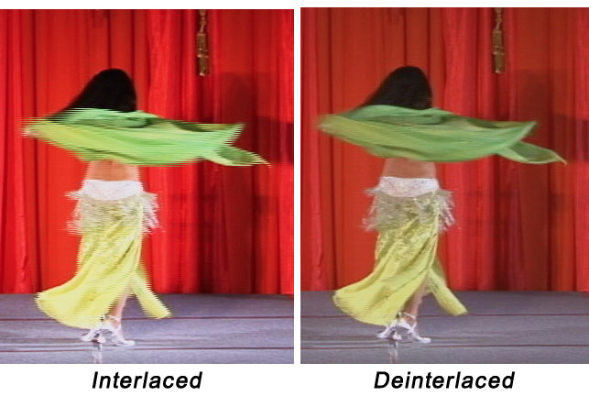
Interlacing
Notes:
Interlacing is a technique that was used in the analog broadcast era to lessen the bandwith required to send video information using a trick of the human eye. Interlacing does not translate well to the frame-by-frame aspect of digital video, so deciding what to do about interlacing artifacts can be a complex choice when preserving archival video.

Slide 16
Playback speed
Notes:
Open reel audio was designed to have the ability to record at different speeds. Recording at a lower speed could capture more content on the tape at a lower quality – the equivalent of a ‘long play’ VHS tape. Without knowing what speed the media was recorded at, the content will not play back correctly.

Slide 17
Frame rate
Notes:
The frame rate is the number of frames displayed over the course of one second of video. In the US, film was generally played at 24 frames per second, while color television was usually broadcast at 29.97 frames per second (why 29.97? Because black and white video was broadcast at 30 fps, and the engineers had to lower the frame rate to allow for color information to be transmitted).

Slide 18
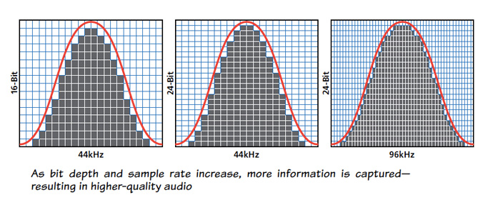
Sampling rate
Notes:
Sampling rate is similar to frame rate – it’s the number of audio samples tracked for every second of audio. A higher sampling rate will create a richer sound, replicating more closely the analog curve of how our ear hears a sound wave.

Slide 19
Bit depth
Notes:
In audio, bit depth refers to the number of bits of information in each audio sample. In video, it refers to the number of bits used to indicate the color of a single pixel. As with sampling rate and audio bit depth, greater video bit depth allows the opportunity to describe a greater range of colors in a digital file.

Slide 20
Aspect ratio
Notes:
Aspect ratio describes the width and height of an image on a screen. An image played back at the wrong aspect ratio will look squashed or elongated.

Slide 21
Data rate
Notes:
Data rate is the size of the video file per second of data. The data rate can vary based on how much information the video file contains at any given point. [Discuss briefly the difference between a variable and constant data rate.]

Slide 22
2. Production Workflow
What makes audiovisual media complex?

Slide 23
Production Workflow
Production Elements
Intermediate Materials
Final Materials
Raw Footage
Rough Cut
Broadcast master
Narration
Interpositive/Internegative
Distribution master
Music/Effects
Avid Media Project
International master
Notes:
These are examples of some of the elements that go into an edited piece of media for broadcast or distribution – though not all media goes through this kind of workflow, if you remember back to the slide on types of audiovisual content.

Slide 24
Some types of audiovisual content
Commercial film
Home movie
Television episode
Television series
Radio program
Album
Event recording
Oral history
Podcast
Educational video
TikTok video
Surveillance footage
Notes:
A commercial film or a television series is likely to have a lot of production elements, intermediate materials, and associated media; a TikTok video or a piece of surveillance footage will likely only exist as a single unique object.

Slide 25
Audiovisual material is often collaborative
Producer
Director
Editor
Writer
Actor
Cinematographer
Interviewer
Host
Composer
Choreographer
Graphic Designer
Camera Operator
Notes:
The information that’s important to capture about who was involved in the creation of a piece is going to be different for each institution, so it’s important to think in advance about what will be important to your users. For example, a composer might be a minor role in the creation of a television episode with some incidental music, but a major role in the creation of an album.

Slide 26
contributor
coverage
creator
date
description
format
identifier
language
publisher
relation
rights
source
subject
title
type
Notes:
Dublin Core is a metadata standard designed to be simple and understandable. It consists of only 15 elements. These elements can describe a document or a book very completely.

Slide 27
pbcoreAssetType
pbcoreAssetDate
pbcoreIdentifier
pbcoreTitle
pbcoreSubject
pbcoreDescription
pbcoreGenre
pbcoreRelation
pbcoreRelationType
pbcoreRelationIdentifer
pbcoreCoverage
coverage
coverageType
pbcoreAudienceLevel
pbcoreAudienceRating
pbcoreCreator
creator
creatorRole
pbcoreContributor
contributor
contributorRole
pbcorePublisher
publisher
publisherRole
pbcoreInstantiation*
pbcoreRightsSummary
rightsSummary
rightsLink
rightsEmbedded
pbcorePart
pbcoreAnnotation
pbcoreExtension
extensionWrap
extensionElement
extensionValue
extensionAuthorityUsed
extensionEmbedded
Notes:
PBCore takes the basic concept of Dublin Core and adds additional elements that the original creators – public media professionals – felt were important to accurately describe the content that they were creating.

Slide 28
instantiationChannelConfiguration
instantiationLanguage
instantiationAlternativeModes
instantiationEssenceTrack*
instantiationRelation
instantiationRelationType
instantiationRelationIdentifier
instantiationRights
rightsSummary
rightsLink
rightsEmbedded
instantiationAnnotation
instantiationPart
pbcoreExtension
extensionWrap
extensionElement
extensionValue
extensionAuthorityUsed
extensionEmbedded
pbcoreInstantiation
instantiationIdentifer
instantiationDate
instantiationDimensions
instantiationPhysical
instantiationDigital
instantiationStandard
instantiationLocation
instantiationMediaType
instantiationGenerations
instantiationTimeStart
instantiationFileSize
instantiationDuration
instantiationDataRate
instantiationColors
instantiationTracks
*essenceTrackType
essenceTrackIdentifier
essenceTrackStandard
essenceTrackEncoding
essenceTrackDataRate
essenceTrackFrameRate
essenceTrackPlaybackSpeed
essenceTrackSamplingRate
essenceTrackBitDepth
essenceTrackFrameSize
essenceTrackAspectRatio
essenceTrackTimeStart
essenceTrackDuration
essenceTrackLanguage
essenceTrackAnnotation
essenceTrackExtension
extensionWrap
extensionEmbedded
Notes:
PBCore also adds the ability to describe media on two levels – the ‘asset,’ or intellectual content, and ‘instantiation,’ or the way that intellectual content is presented in the world. We’ll talk more about that in next week’s presentation on the structure of PBCore.

Slide 29
Exercise
Find a piece of audiovisual content in your home or office – a VHS, a DVD or CD, a video on your cell phone
Use the attached Dublin Core cataloging form to capture as much information as you can about your content. What is the format? Does it have a title? A description?
List any important characteristics of your item that you had questions about how to record in Dublin Core

Slide 30
rebecca_fraimow@wgbh.org
Join us for our next webinar!
PBCore Structure
Wednesday September 29
12:30 PM ET
OPTIONAL HOMEWORK
Complete a Dublin Core cataloging form and email it to me for review
Send me a case study from your organization for the final class on metadata modeling!

